Slide 1


Capstone project supermarket analysis

Slide 2

Team Members Of Group A
Ahmed Mostafa
Mostafa Ahmed
Esraa Arafa
Omar Khadrawy
Eng. Youssef Ezz

Slide 3
Motivation
Introduction
Data problems
Solutions
Data
finding
Recommendation
Future Work
03
02
04
05
06
Agenda
01

Slide 4
Motivation
Introduction
Data problems
Solutions
Data
finding
Recommendation
Future Work
06
05
04
03
02
01

Slide 5

Motivation
‍‍‌‌‎
Managed Infinity Supermarket's expansion to three cities in Myanmar: Yangon, Naypyitaw, and Mandalay.
Each team member managed one branch, while the owner oversaw the entire operation over a three-month period.
Tracked sales, customer data, and satisfaction across product lines, genders, and payment methods.
Now focusing on analyzing the data to evaluate branch performance and uncover insights for future success.

Slide 6
Introduction
The dataset for Infinity Supermarket contains detailed records of transactions across its three branches in Yangon, Naypyitaw, and Mandalay, covering a three-month period. The data tracks crucial aspects such as Invoice ID, branch location, and customer type (regular vs. new), as well as customer gender and the product line they purchased from. Additionally, it includes unit prices, quantities, and the total sales with 5% tax applied. Other important fields are the transaction date and time, payment methods, and customer satisfaction ratings.

Slide 7

Data Description
This dataset offers a comprehensive view of Infinity Supermarket's transactions, including:
‍‍‌‌‎
Branch location (Yangon, Naypyitaw, Mandalay), invoice ID, and customer type (regular vs. new)
‍‍‌‌‎
Customer demographics such as gender and the product line they purchased from
‍‍‌‌‎
Key financial details like unit prices, quantities, total sales (including 5% tax), and payment methods
‍‍‌‌‎
Transaction date and time, along with customer satisfaction ratings.

Slide 8

Steps of the project
data Wrangling
Data Visualization
Highlight our findings
Recommendations to increase the performance

Slide 9
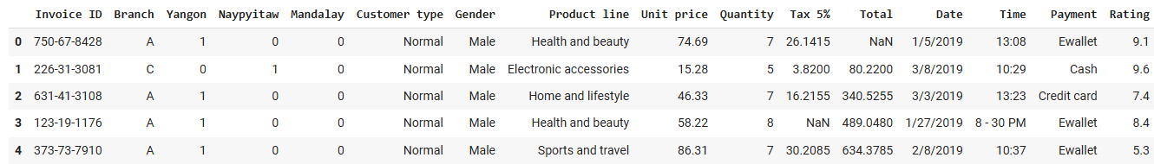
Data definitions

Slide 10
Data definitions
Invoice ID: A unique identifier for each invoice or transaction.

Slide 11
Data definitions
Branch: The branch or location where the transaction occurred.

Slide 12
Data definitions
Yangon: 1st Supermarket Branch

Slide 13
Data definitions
Naypyitaw: 2nd Supermarket Branch

Slide 14
Data definitions
Mandalay: 3rd Supermarket Branch

Slide 15
Data definitions
Customer type: Indicates whether the customer is a regular(member) or new customer(normal).

Slide 16
Data definitions
Gender: The gender of the customer.

Slide 17
Data definitions
Product line: The category of product.

Slide 18
Data definitions
Unit price: : The price of a single unit of the product.

Slide 19
Data definitions
Quantity: The number of units of the product.

Slide 20
Data definitions
Tax 5%: The amount of tax 5% of the total cost which applied to the transaction.

Slide 21
Data definitions
Total: The total cost of the transaction, including tax.

Slide 22
Data definitions
Date: The date when the transaction took place.

Slide 23
Data definitions
Time: The time of day when the transaction occurred.

Slide 24
Data definitions
Payment: The payment method used.

Slide 25
Data definitions
Rating: Customer satisfaction rating

Slide 26
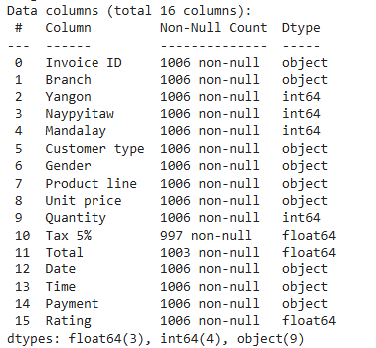
Data Types
(1006, 16)

Slide 27
Problem definitions
Tidiness Issue: The issue is that there are three separate columns for cities: Yangon, Naypyitaw, and Mandalay. According to the tidy data principle, there should be a single City column with the corresponding values, not separate columns for each city.

Slide 28
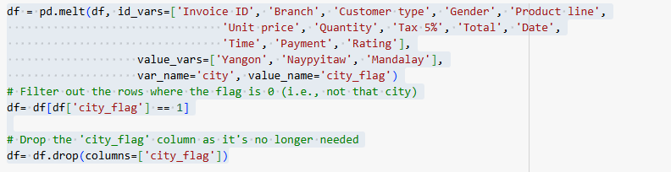
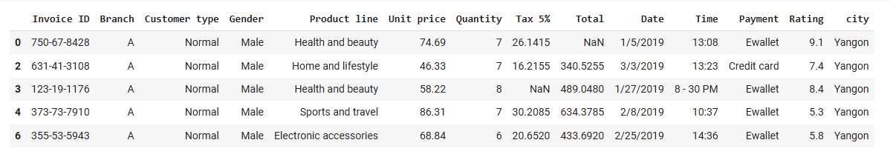
Solution
We need to melt the data and make a new column for city

Slide 29
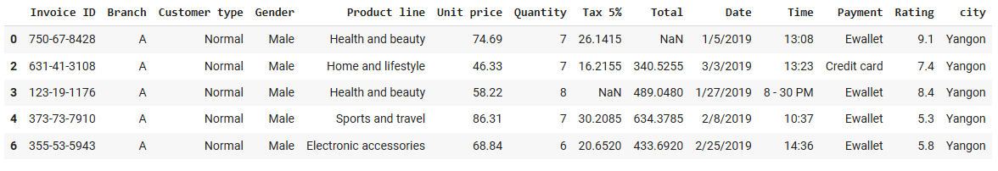
Problem definitions
Order Issue: After using the melt function , the order of index chanded , so we will get back the normal order

Slide 30

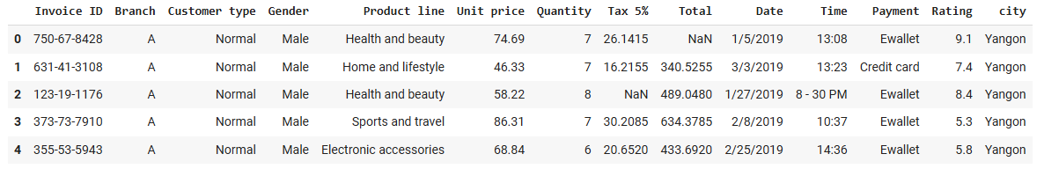
Solution
We need to reset the Data's index

Slide 31
Problem definitions
Quality Issue (Validity): the exsistence of negative values

Slide 32

Solution
Replace the negative values with positive values.

Slide 33
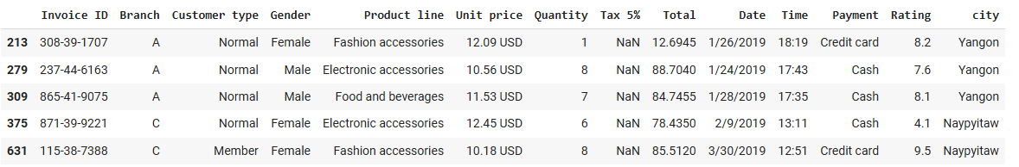
Problem definitions
Quality Issue (Inconsistency): In Price column Must remove "USD" from the rows that contain it to standardize the data type in the column as only numerical values .

Slide 34

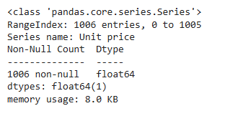
Solution
Delete "USD" From Price to standardize the data type in the column as numeric values.

Slide 35
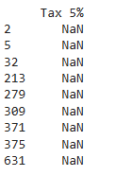
Problem definitions
Quality Issue (Missing values): missing values in Tax 5% and Total.

Slide 36


Solution
Handle missing values in Tax 5% and Total by Create New Columns based on (Price and Quantity)

Slide 37
Problem definitions
Quality Issue (Inconsistency): The time "8-30 PM" is incorrectly formatted and should adhere to a consistent format.

Slide 38
Solution
In Time col, we Need to Replace '8 - 30 PM' with '20:30'

Slide 39

Problem definitions
Quality Issue (Validity): Data Type of Date is Object

Slide 40

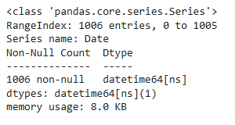
Solution
Convert Data Type of Date From Object To Date

Slide 41
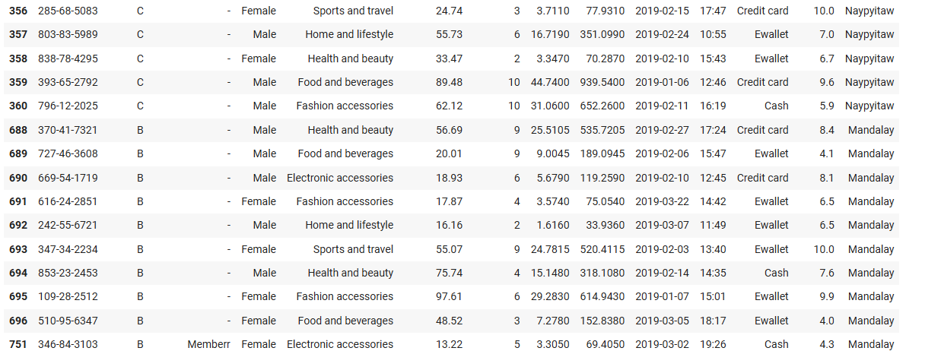
Problem definitions
Quality Issue (Spelling Errors): word "memberr" instead of "member”

Slide 42

Solution
In the Customer type col, Replace Spelling error of "Memberr" to "Member" And "-" to "Normal"

Slide 43
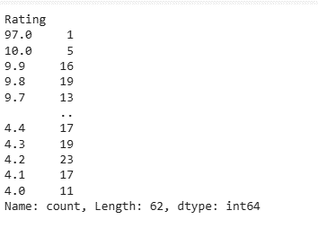
Problem definitions
Quality Issue (Inaccurate Values): Replace "97" in Rating by 9.7

Slide 44

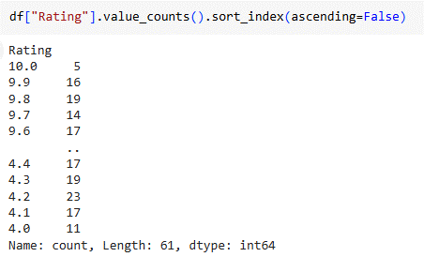
Solution
Replace "97" in Rating by 9.7

Slide 45

Problem definitions
Quality Issue (Duplicate Records): The existence of duplicates

Slide 46


Solution
Remove Duplicates

Slide 47
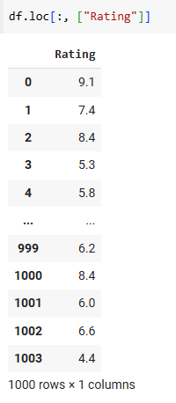
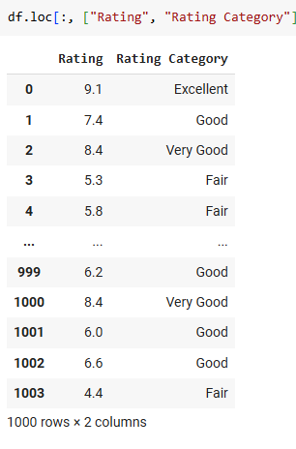
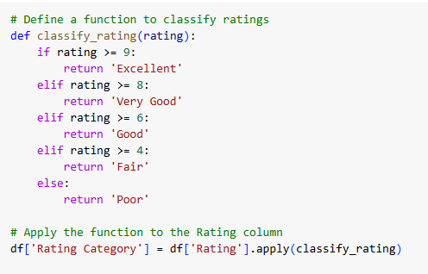
Classify Rating

Slide 48
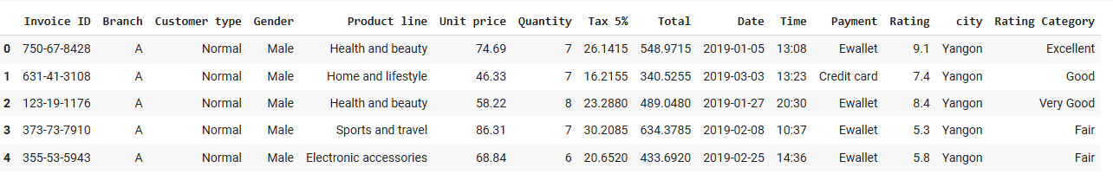
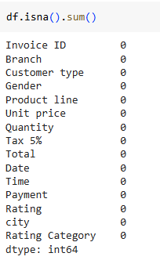
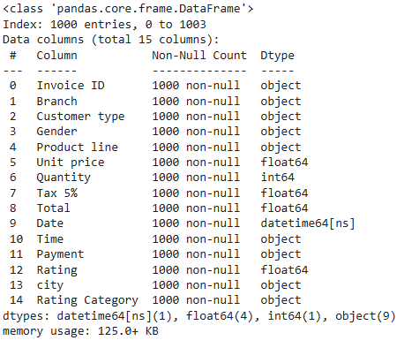
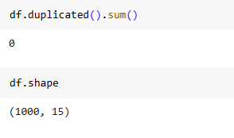
Final Results

